Slide 1

Uncovering Insights from Kenya Airways Customer Reviews
A Data-driven Analysis of Flight Experience and Service Quality

Slide 2
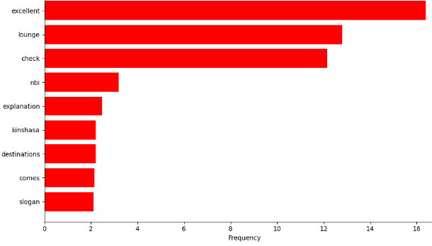
Key Findings
Key Topics
Sentiment Analysis
Passengers express positive sentiments, describing experiences as "excellent." Terms like "check" and "lounge" indicate smooth processes and comfort. These insights guide Kenya Airways in enhancing service quality and amenities.
Out of 459 reviews analyzed, 301 were classified as Positive, 156 as Negative, and 2 as Neutral.
65.6%
Positive
34.0%
Negative
0.4%
Neutral
Majority of reviews express positive sentiment towards Kenya Airways.

